Slide 1


Robel Equbasilassie Kahsay
August - 2022

Slide 2


Outline
Executive Summary
Introduction
Methodology
Results
Conclusion
Appendix

Slide 3
Executive Summary
The data for this analysis are gathered by making a request to the SpaceX API and by performing Web scrapping on the Wikipedia page to collect and extract Falcon 9 historical launch records.
Various data wrangling techniques are applied to clean and standardize the data and Exploratory Data Analysis (EDA) is performed to find patterns in the data and determine the best features for training supervised models.
Visualizations such as scatter plots, bar charts, and maps are used to analyze the relationship between the dependent and independent variables and select the important features that will be used in prediction.
For predictive analysis models such as Logistic Regression and SVM, DecisionTree classifier, KNeighbors classifier are selected based on their accuracy results.
KSC LC-39A launch site has the highest success rate of landing and it seems that the more massive the payload, the less likely the first stage will return.
Interactive dashboards are built to visualize the relation ship of each launch sites with flight number, payload mass, orbit type and success rate.

Slide 4
Introduction
Space Exploration Technologies Corp. (doing business as SpaceX) is an American spacecraft manufacturer, space launch provider, and a satellite communications corporation headquartered in Hawthorne, California.
SpaceX was founded in 2002 by Elon Musk, with the goal of reducing space transportation costs to enable the colonization of Mars.
SpaceX advertises Falcon 9 rocket launches on its website with a cost of 62 million dollars; other providers cost upward of 165 million dollars each, much of the savings is because SpaceX can reuse the first stage.
The goal of this data science capstone project is to predict if the Falcon 9 first stage will land successfully. Therefore if we can determine if the first stage will land, we can determine the cost of a launch.

Slide 5

Section 1

Slide 6
Methodology
Executive Summary
Data collection methodology:
By making a request to the SpaceX API and by performing Web Scrapping on the Wikipedia page titled List of Falcon 9 and Falcon Heavy launches to collect and extract Falcon 9 historical launch records.
Perform data wrangling
By Identifying missing data, counting the landing outcomes to rewrite it as classes of 0 and 1 and success rate of Falcon 9 is calculated.
Perform exploratory data analysis (EDA) using visualization and SQL
Perform interactive visual analytics using Folium and Plotly Dash
Perform predictive analysis using classification models
Predictor features selected from independent variables, data is standardized/scaled, train and test data split is done, best hyperparameter for classification models are calculated by tuning parameters then models are trained.

Slide 7
Data Collection
Data collection is done using two processes
1. Making a request to the SpaceX API
The following URLs are used to call the SpaceX API using the requests library and parse the JSON results to extract information using identification numbers in the launch data;
spacex_url = https://api.spacexdata.com/v4/launches/past
static_json_url = https://cf-courses-data.s3.us.cloud-object-storage.appdomain.cloud/IBM-DS0321EN-SkillsNetwork/datasets/API_call_spacex_api.json
2. Perform Web scrapping on the Wikipedia page titled List of Falcon 9 and Falcon Heavy launches.
The Falcon 9 launch records are extracted from Wikipedia by parsing the HTML table into a Pandas data frame using Beautifulsoup4 and requests libraries from the following URL;
static_url = https://en.wikipedia.org/w/index.php?title=List_of_Falcon_9_and_Falcon_Heavy_launches&oldid=1027686922

Slide 8
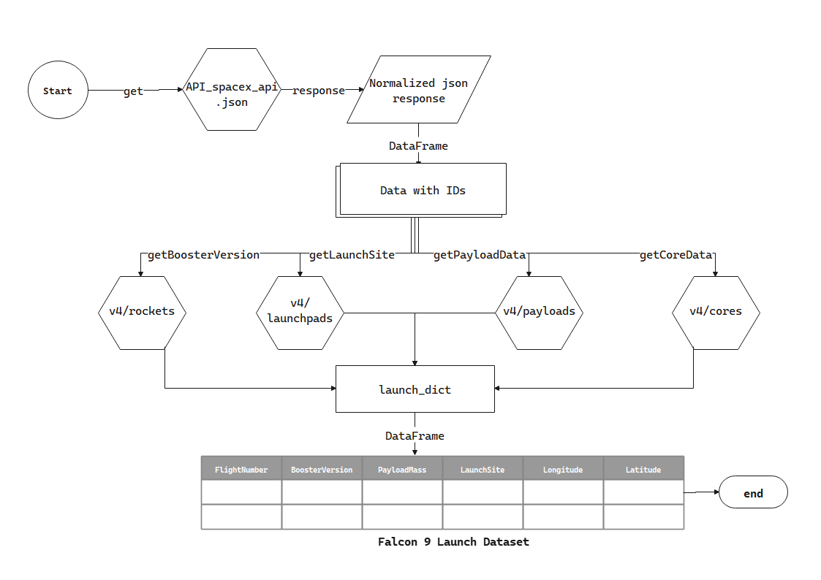
Data Collection – SpaceX API
Request and parse the SpaceX launch data using the GET request
response = requests.get("https://api.spacexdata.com/v4/rockets/...").json()
response = requests.get("https://api.spacexdata.com/v4/launchpads/...").json()
response = requests.get("https://api.spacexdata.com/v4/payloads/...").json()
response = requests.get("https://api.spacexdata.com/v4/cores/...").json()
response = requests.get("...")
FlightNumber, BoosterVersion, PayloadMass, Orbit, LaunchSite, Outcome, Longitude, Latitude data are extracted from the SpaceX API into a Panda data frame.
GitHub URL: https://github.com/robeleq/IBM_Applied_Data_Science_Capstone_Project/blob/main/01_DataCollection/jupyter-labs-spacex-data-collection-api.ipynb
Flowchart of SpaceX API calls

Slide 9
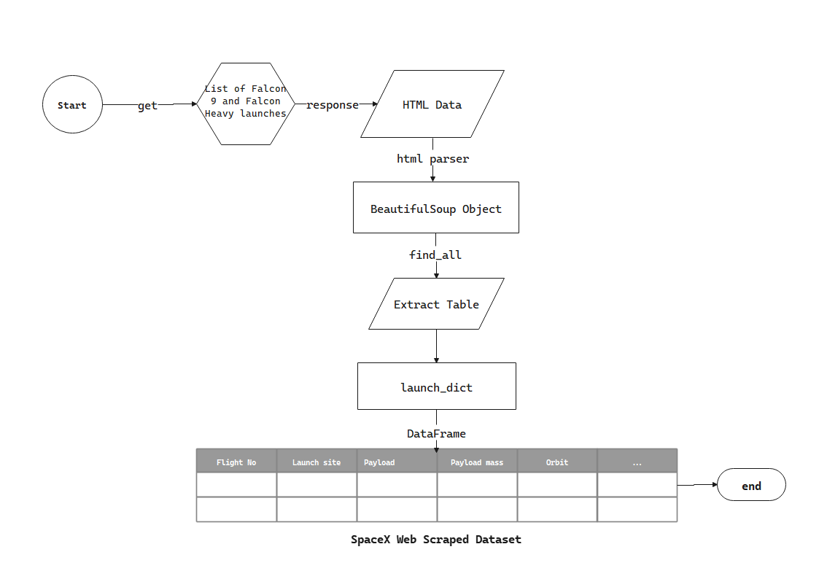
Data Collection - Scraping
Request and extracted the Wikipedia Falcon 9 launch records using Beautifulsoup4 and requests libraries
response = requests.get("https://en.wikipedia.org/w/index.php?title=List_of_Falcon_9_and_Falcon_Heavy_launches&oldid=1027686922")
soup = BeautifulSoup(response.text, "html.parser")
soup.find_all('table',"wikitable plainrowheaders collapsible")
Falcon 9 launch records are extracted from Wikipedia table rows.
Flight No., Launch site, Payload, Payload mass, Orbit, Customer, Launch outcome, Version Booster, Booster landing data are parsed from the Wikipedia table into a Panda data frame.
GitHub URL: https://github.com/robeleq/IBM_Applied_Data_Science_Capstone_Project/blob/main/01_DataCollection/jupyter-labs-webscraping.ipynb
Flowchart of web scraping

Slide 10
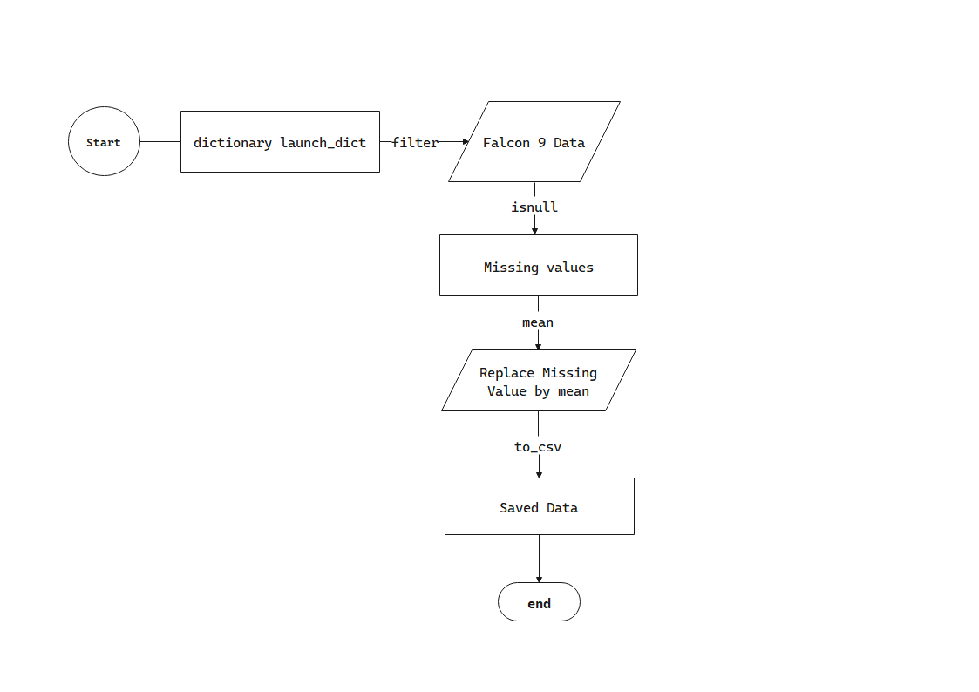
Data Wrangling
Filter the dataframe to only include Falcon 9 launches using the BoosterVersion column
data_falcon9 = data[data['BoosterVersion'] == 'Falcon 9']
Check for missing values in our dataset.
data_falcon9.isnull().sum()
Identified missing values for PayloadMass is 5 and LandingPad is 26
Dealing with Missing Values
Mean values are calculated for the PayloadMass column's payload mass, and each missing value is replaced by the mean values.
Calculate the mean value of PayloadMass column
mean_PayloadMass = data_falcon9['PayloadMass'].mean()
Replace the np.nan values with its mean value
data_falcon9['PayloadMass'].fillna(mean_PayloadMass, inplace=True)
GitHub URL: https://github.com/robeleq/IBM_Applied_Data_Science_Capstone_Project/blob/main/02_DataWrangling/labs-jupyter-spacex-Data%20wrangling.ipynb
Flowchart of Data Wrangling

Slide 11
EDA with Data Visualization
Plots such as scatter plots and bar charts are used to visualize the relationship between parameters.
GitHub URL: https://github.com/robeleq/IBM_Applied_Data_Science_Capstone_Project/blob/main/03_EDA/jupyter-labs-eda-dataviz.ipynb
Parameters | Chart Type
FlightNumber vs PayloadMass | Scatter Plot
FlightNumber vs LaunchSite | Scatter Plot
PayloadMass vs LaunchSite | Scatter Plot
FlightNumber vs Orbit | Scatter Plot
PayloadMass vs Orbit | Scatter Plot
Orbit vs Success Rate | Bar chart

Slide 12
EDA with SQL
Display the names of the unique launch sites in the space mission
Display 5 records where launch sites begin with the string 'CCA'
Display the total payload mass carried by boosters launched by NASA (CRS)
Display average payload mass carried by booster version F9 v1.1
List the date when the first successful landing outcome in ground pad was acheived
List the names of the boosters which have success in drone ship and have payload mass greater than 4000 but less than 6000
List the total number of successful and failure mission outcomes
List the names of the booster_versions which have carried the maximum payload mass. Use a subquery
List the failed landing_outcomes in drone ship, their booster versions, and launch site names for in year 2015
Rank the count of landing outcomes (such as Failure (drone ship) or Success (ground pad)) between the date 2010-06-04 and 2017-03-20, in descending order
GitHub URL: https://github.com/robeleq/IBM_Applied_Data_Science_Capstone_Project/blob/main/03_EDA/jupyter-labs-eda-sql-coursera.ipynb

Slide 13
Build an Interactive Map with Folium
Folium objects with their importance are listed below
GitHub URL: https://github.com/robeleq/IBM_Applied_Data_Science_Capstone_Project/blob/main/04_DataVisualization/lab_jupyter_launch_site_location.ipynb
Map object | Description
Map | To create a base map by passing starting coordinates to Folium
Circle | To clearly visualize the areas centered at the coordinates
Marker | To put location marker with a popup and tooltip HTML
PolyLine | To draw a line between coordinates
MarkerCluster | To simplify a map containing many markers having the same coordinate

Slide 14
Build a Dashboard with Plotly Dash
Pie chart is used to show the total successful launches count for all sites.
For a particular launch site, the pie chart is used to display the Success vs. Failed counts.
Scatter chart is used to show the correlation between payload and launch success
Dropdown list is used to enable Launch Site selection and interact with the dashboard easily.
Range slider is used to select payload range and see the success rate of each launch site along with payload mass.
GitHub URL: https://github.com/robeleq/IBM_Applied_Data_Science_Capstone_Project/blob/main/04_DataVisualization/spacex_dash_app.py

Slide 15
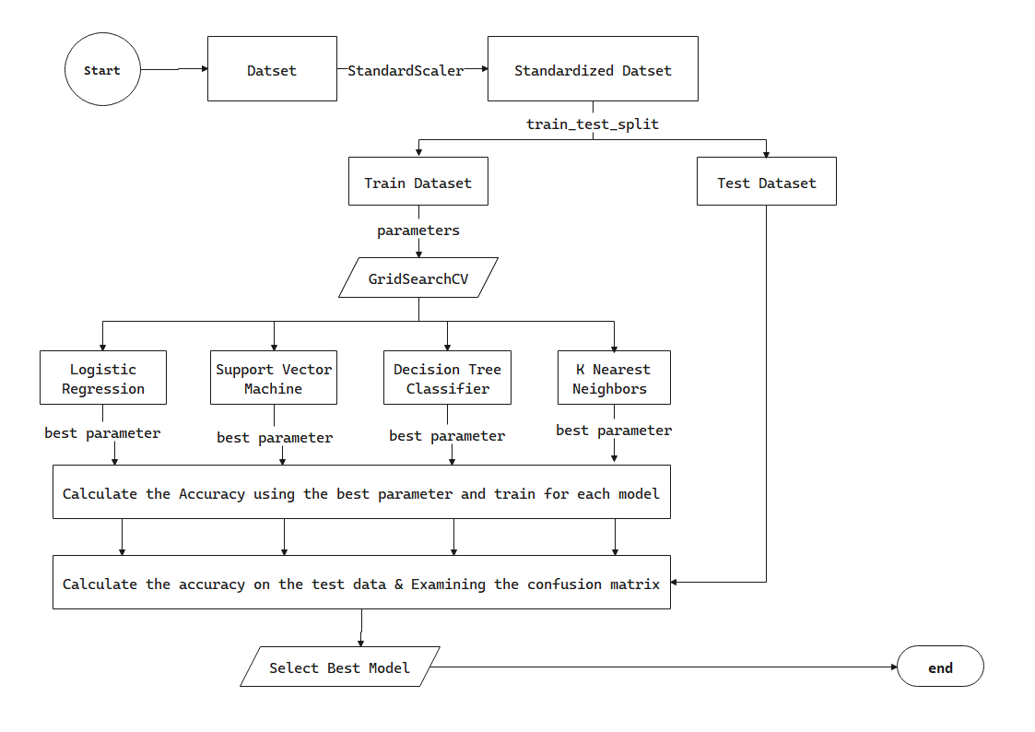
Predictive Analysis (Classification)
Significant predictor features have been selected and the dataset has been standardized to bring all the feature data to the same scale.
The data is split into training and testing data.
Logistic Regression, Support Vector Machine, Decision Tree Classifier, and K Nearest Neighbors are selected to predict the success class.
Using the GridSearchCV function hyperparameters are selected and the models are trained.
By comparing the train test accuracies of each model best model for the data set is identified.
During the training time SVM and Logistic Regression has best performance
GitHub URL: https://github.com/robeleq/IBM_Applied_Data_Science_Capstone_Project/blob/main/05_ML_Modeling/SpaceX_Machine%20Learning%20Prediction_Part_5.ipynb
Flowchart of Modeling

Slide 16
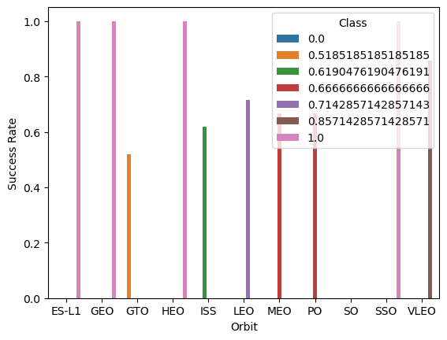
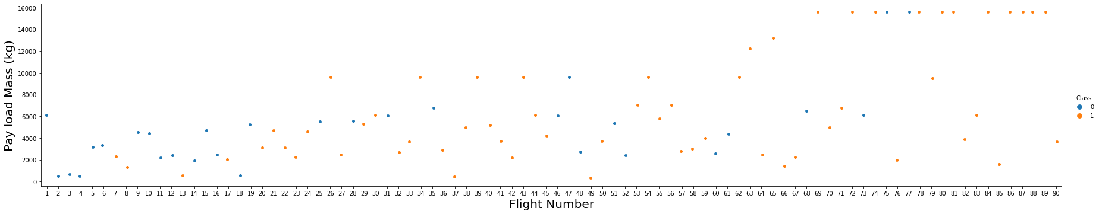
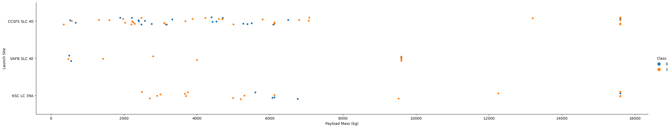
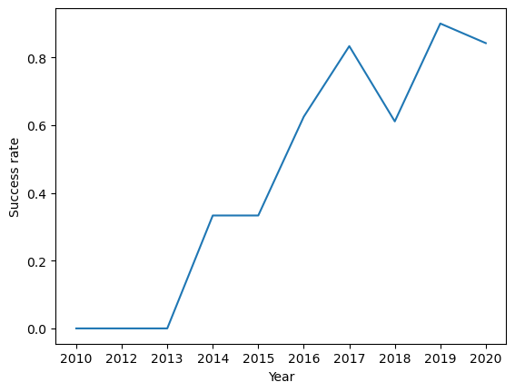
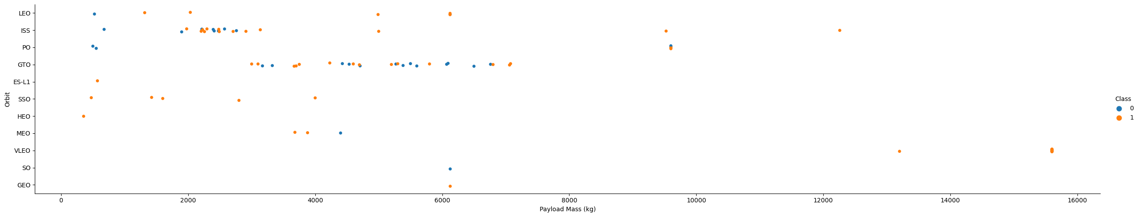
Results
Exploratory data analysis results

Slide 17
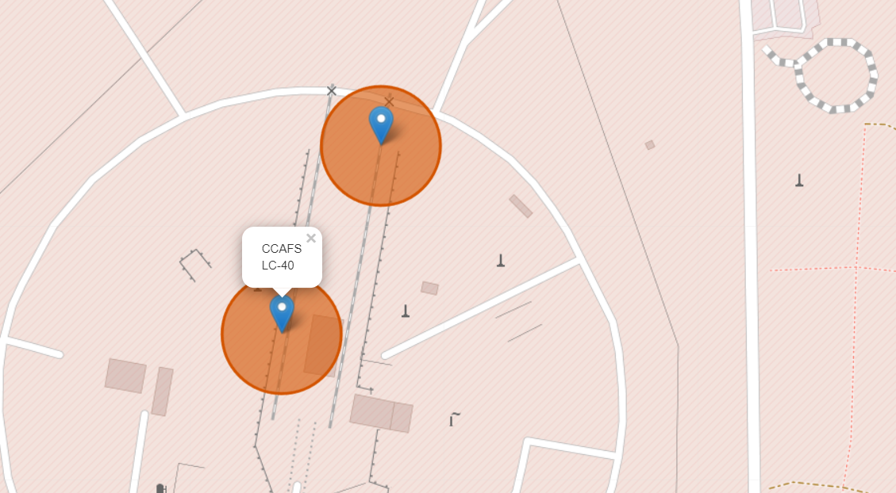
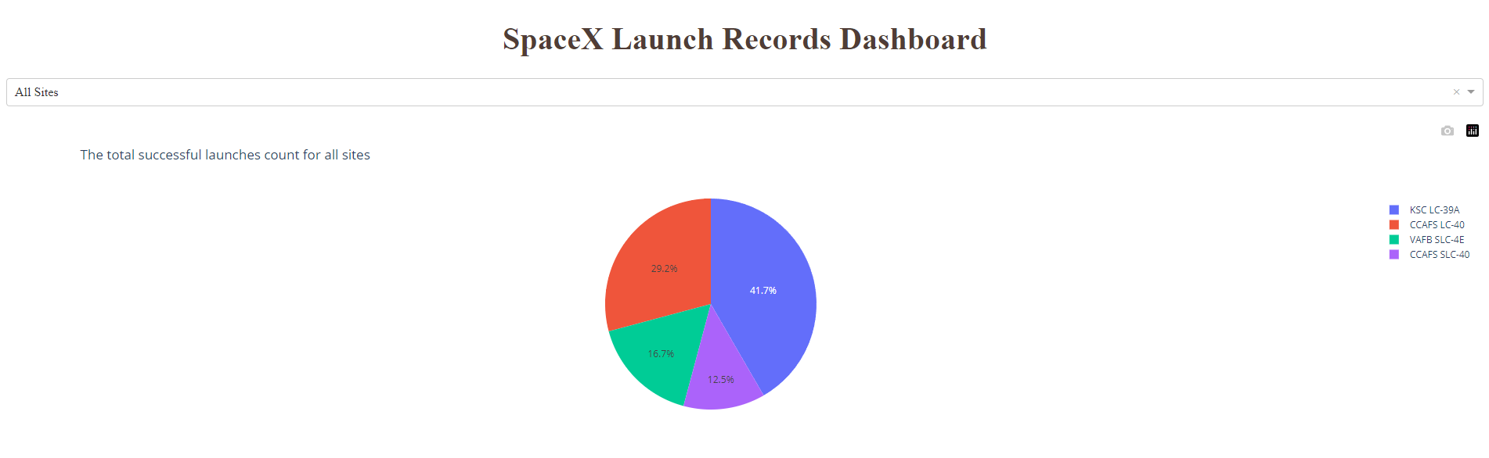
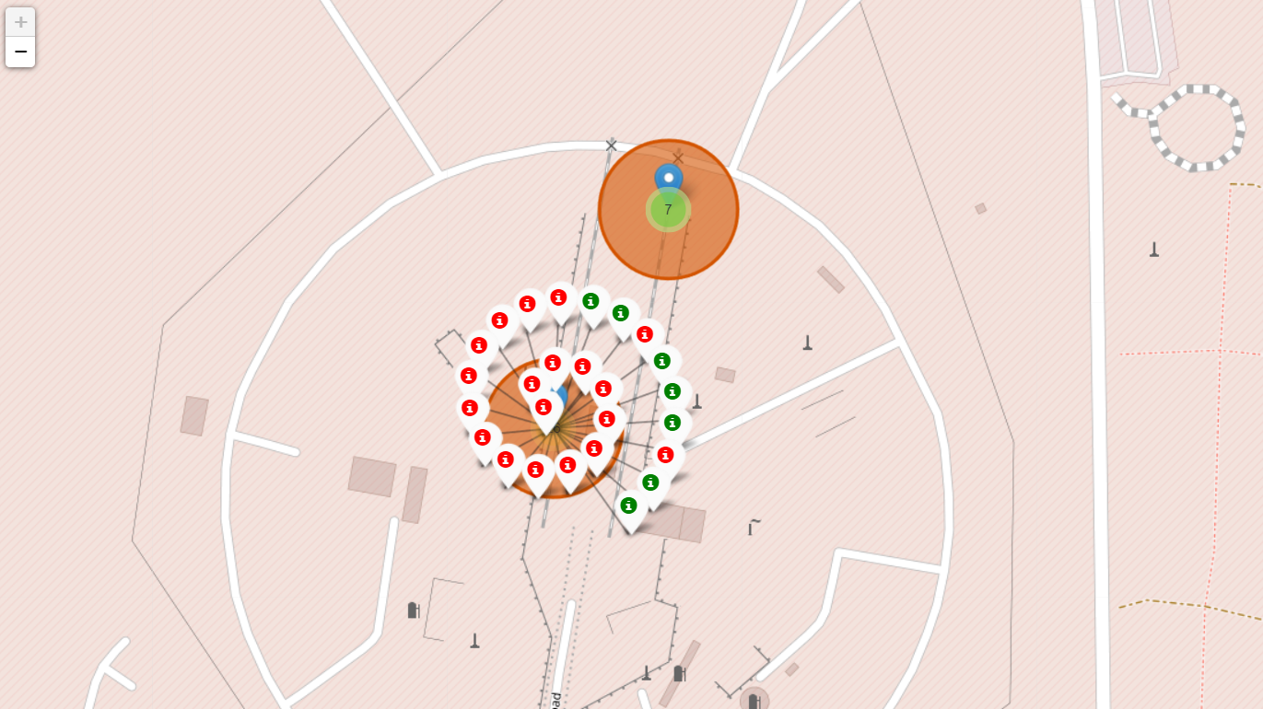
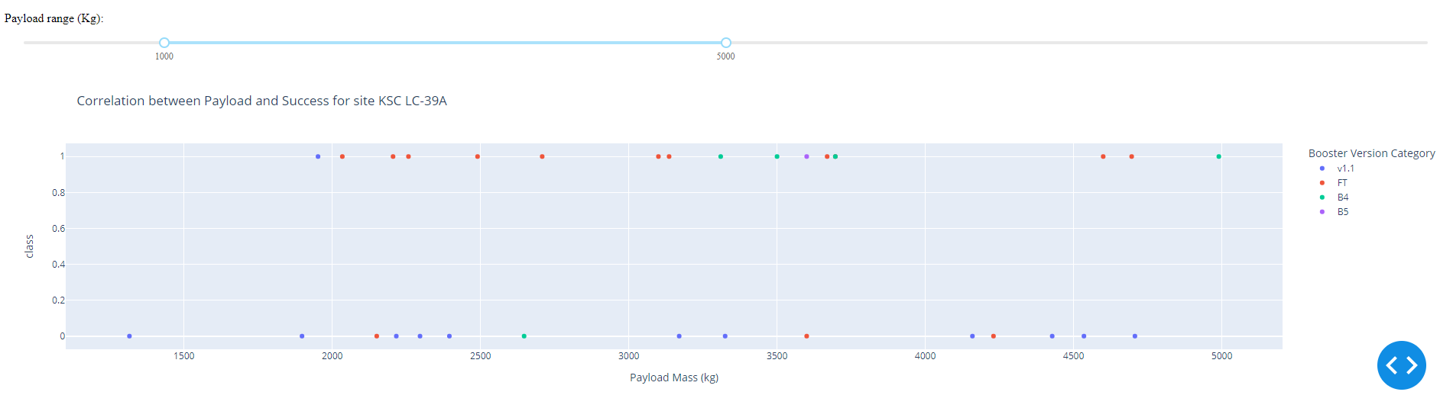
Results
Interactive analytics demo in screenshots

Slide 18
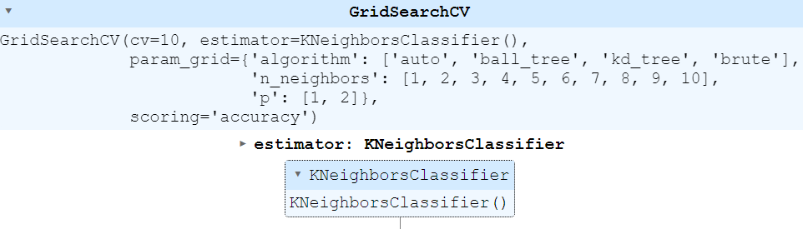
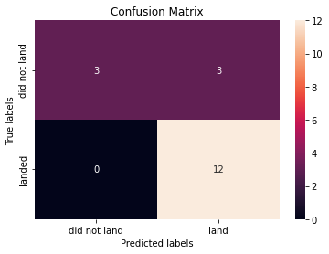

Results
Predictive analysis results

Slide 19

Section 2

Slide 20
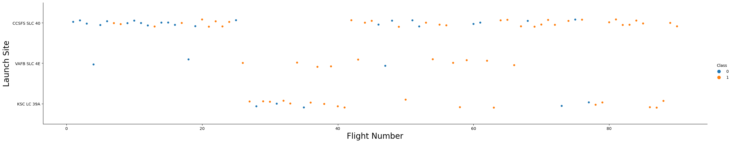
Flight Number vs. Launch Site
With 26 launches, CCAFS LC-40 launch site has the largest number of launches.
With 10 successful launches, KSC LC-39A launch site has the largest successful launches.

Slide 21
Payload vs. Launch Site
There are no launches at the VAFB-SLC 4E launch site with heavy payload masses (greater than 10,000).
Launch stations CCAFS SLC 40 and KSC LC 39A have significantly higher success rates for rockets with increased payload mass (greater than 10,000)

Slide 22
Success Rate vs. Orbit Type
When compared to other orbits, the ES-LQ, GEO, HEO, and SSO orbits have a higher success rate.

Slide 23
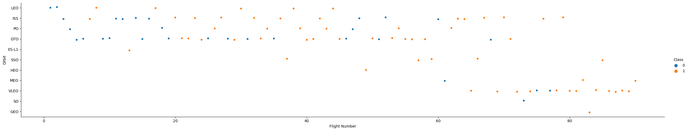
Flight Number vs. Orbit Type
In the LEO orbit the Success appears related to the number of flights
VLEO orbits the Success appears to be higher when the number of flights increase.
There seems to be no relationship between flight number when in GTO orbit.

Slide 24
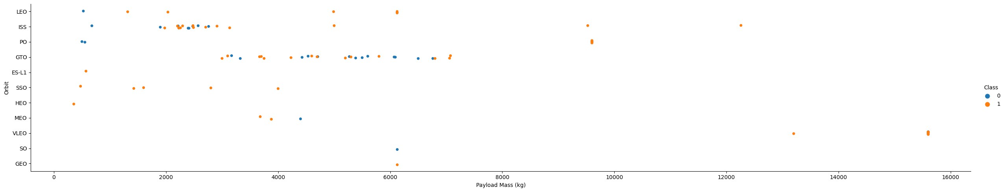
Payload vs. Orbit Type
With heavy payloads the successful landing or positive landing rate are more for Polar, LEO and ISS.
However for GTO we cannot distinguish this well as both positive landing rate and negative landing (unsuccessful mission) are both there here.

Slide 25
Launch Success Yearly Trend
It can be see that since 2013, the success rate has been rising until 2020.

Slide 26
All Launch Site Names
The names of the unique launch sites are
CCAFS LC-40
SC LC-39A
VAFB SLC-4E
CCAFS SLC-40

Slide 27
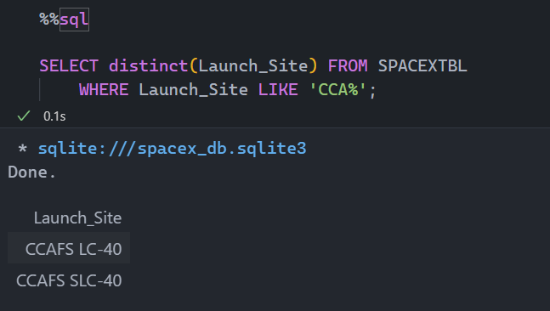
Launch Site Names Begin with 'CCA'
There are only two records where launch sites name begin with `CCA`
CCAFS SLC-40
CCAFS LC-40

Slide 28
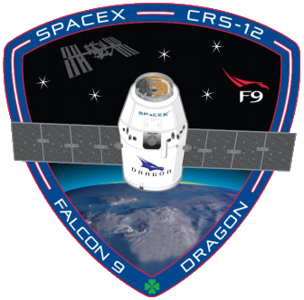
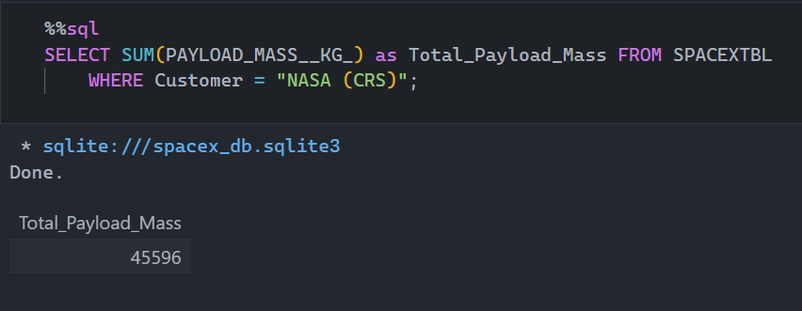
Total Payload Mass
The total payload mass carried by boosters launched by NASA (CRS) is 45,596 Kg
It is calculated by adding the payload mass carried by boosters launched by NASA (CRS)

Slide 29
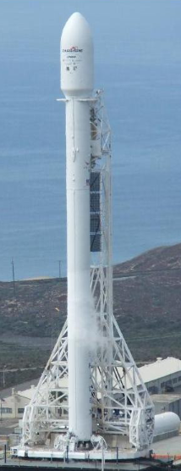
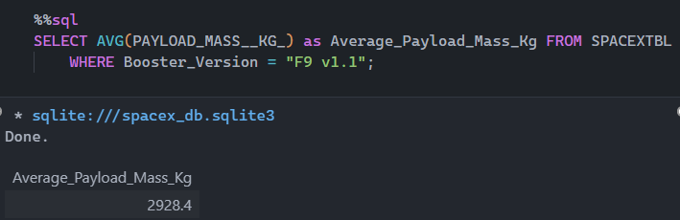
Average Payload Mass by F9 v1.1
The average payload mass carried by booster version F9 v1.1 is 2,928.40 Kg

Slide 30
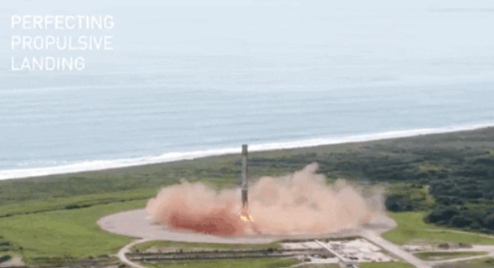
First Successful Ground Landing Date
The first successful landing outcome in ground pad was achieved in 2015-12-22

Slide 31
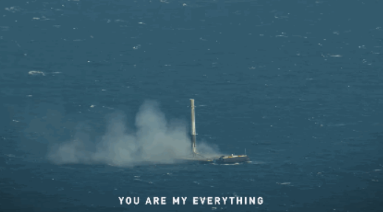
Successful Drone Ship Landing with Payload between 4000 and 6000
The names of boosters which have successfully landed on drone ship and had payload mass greater than 4000 but less than 6000
F9 FT B1022
F9 FT B1026
F9 FT B1021.2
F9 FT B1031.2

Slide 32
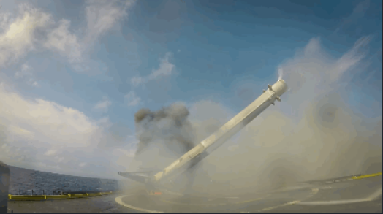
Total Number of Successful and Failure Mission Outcomes
Successful mission outcomes are 100
Failure mission outcome is 1

Slide 33
Boosters Carried Maximum Payload
The names of the booster which have carried the maximum payload mass
F9 B5 B1048.4
F9 B5 B1049.4
F9 B5 B1051.3
F9 B5 B1056.4
F9 B5 B1048.5
F9 B5 B1051.4
F9 B5 B1049.5
F9 B5 B1060.2
F9 B5 B1058.3
F9 B5 B1051.6
F9 B5 B1060.3
F9 B5 B1049.7

Slide 34
2015 Launch Records
The failed landing_outcomes in drone ship, their booster versions, and launch site names for in year 2015 are listed below
Year | Booster Version | Launch Site | Landing Outcome
2015 | F9 v1.1 B1012 | CCAFS LC-40 | Failure (drone ship)
2015 | F9 v1.1 B1015 | CCAFS LC-40 | Failure (drone ship)

Slide 35
Rank Landing Outcomes Between 2010-06-04 and 2017-03-20
The rank count of landing outcomes (such as Failure (drone ship) or Success (ground pad)) between the date 2010-06-04 and 2017-03-20, in descending order
Landing _Outcome | Count | Rank_no
No attempt | 10 | 8
Failure (drone ship) | 5 | 5
Success (drone ship) | 5 | 5
Success (ground pad) | 5 | 5
Controlled (ocean) | 3 | 4
Uncontrolled (ocean) | 2 | 3
Failure (parachute) | 1 | 1
Precluded (drone ship) | 1 | 1

Slide 36

Section 3

Slide 37
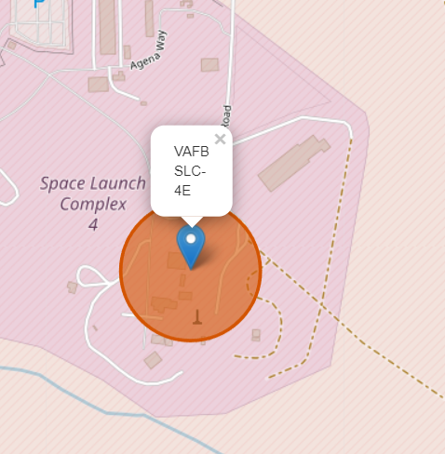
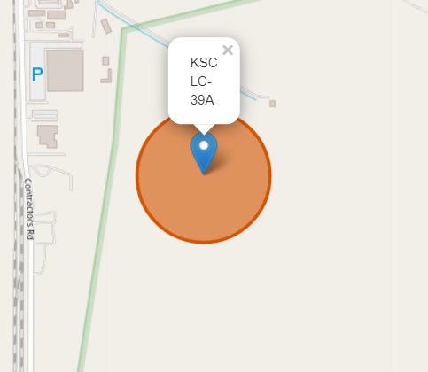
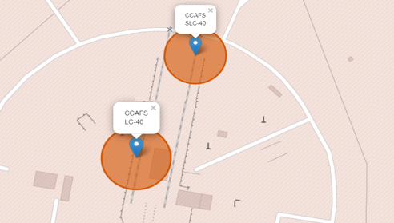
Launch Sites Location Analysis
All launch sites are in proximity to the equator and the coast.
The launch sites in close proximity to the coast are for safety reasons.

Slide 38
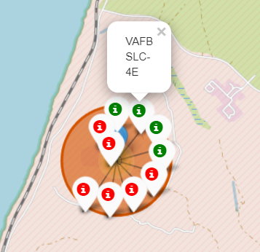
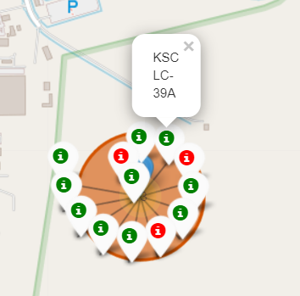
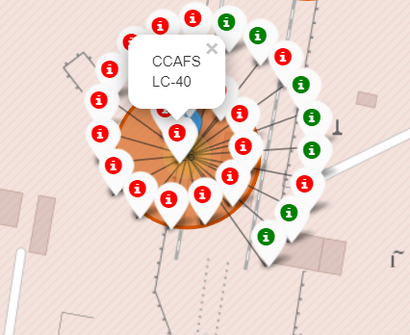
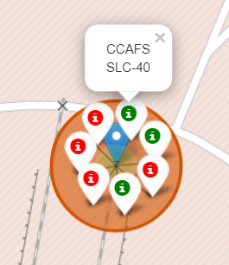
Launch Sites Location and Success Rate
KSC LC 39A Launch site has the highest success rate compared to all launch sites

Slide 39
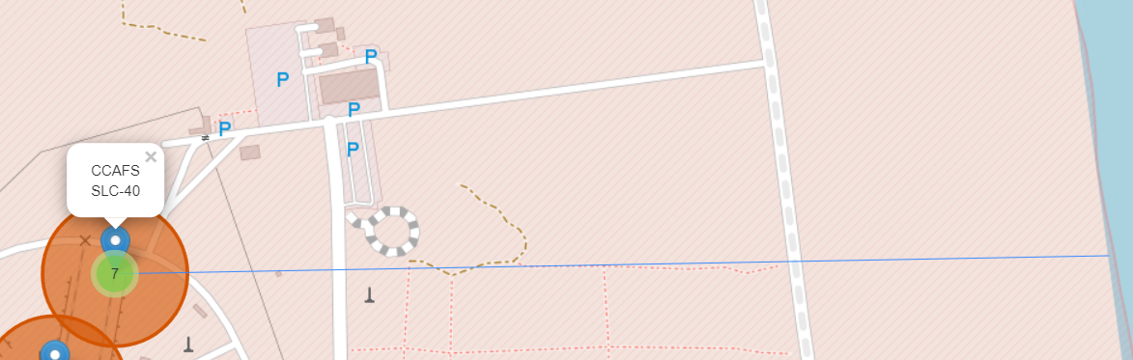
Distances between a launch site to its proximities
Launch sites are in close proximity to coastline.
Launch sites are not in close proximity to cities, which minimizes danger to population dense areas.

Slide 40

Section 4

Slide 41
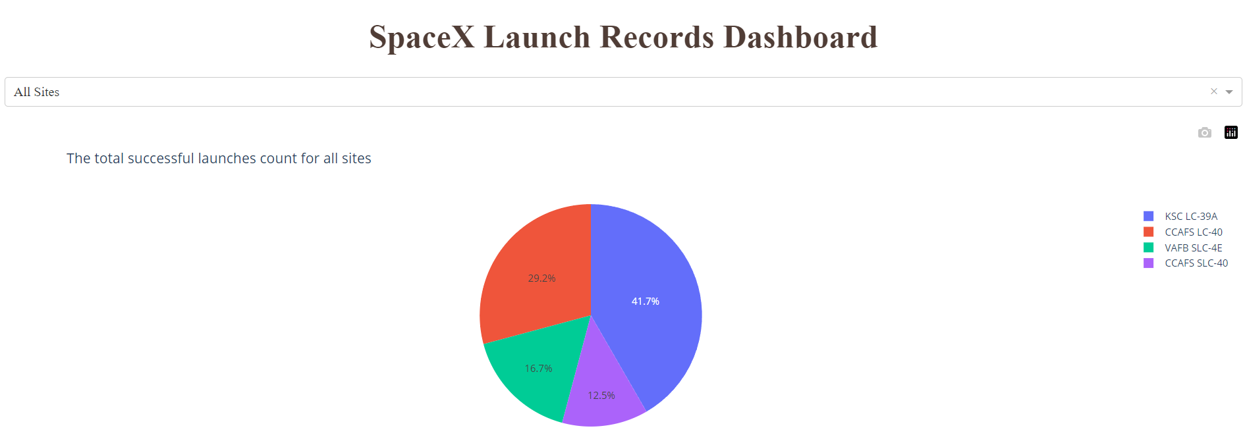
Launch sites success rate dashboard
The Pie chart shows the total successful launches count for all sites
KSC LC-39A launch site has the largest successful launches

Slide 42
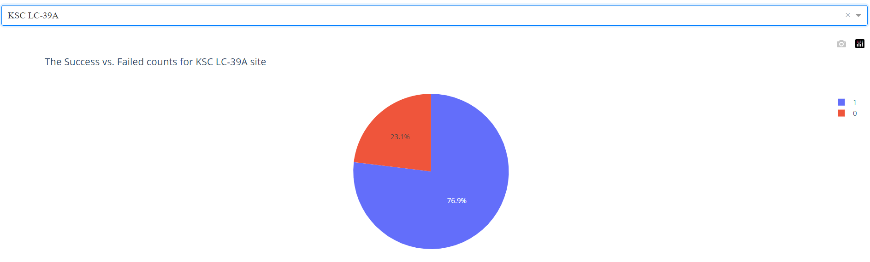
The highest success rate launch site dashboard
According to Pichart of the dashboard, the landing at the KSC LC-39A launch site was successful in about 77% of launch cases.

Slide 43
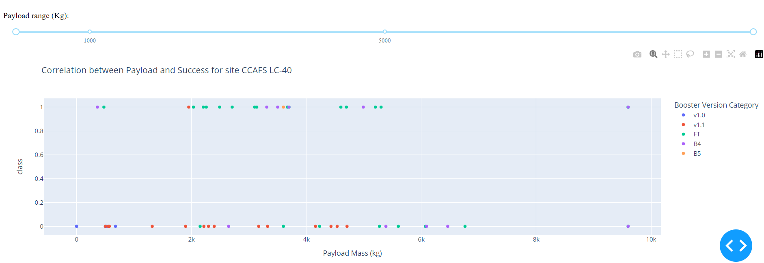
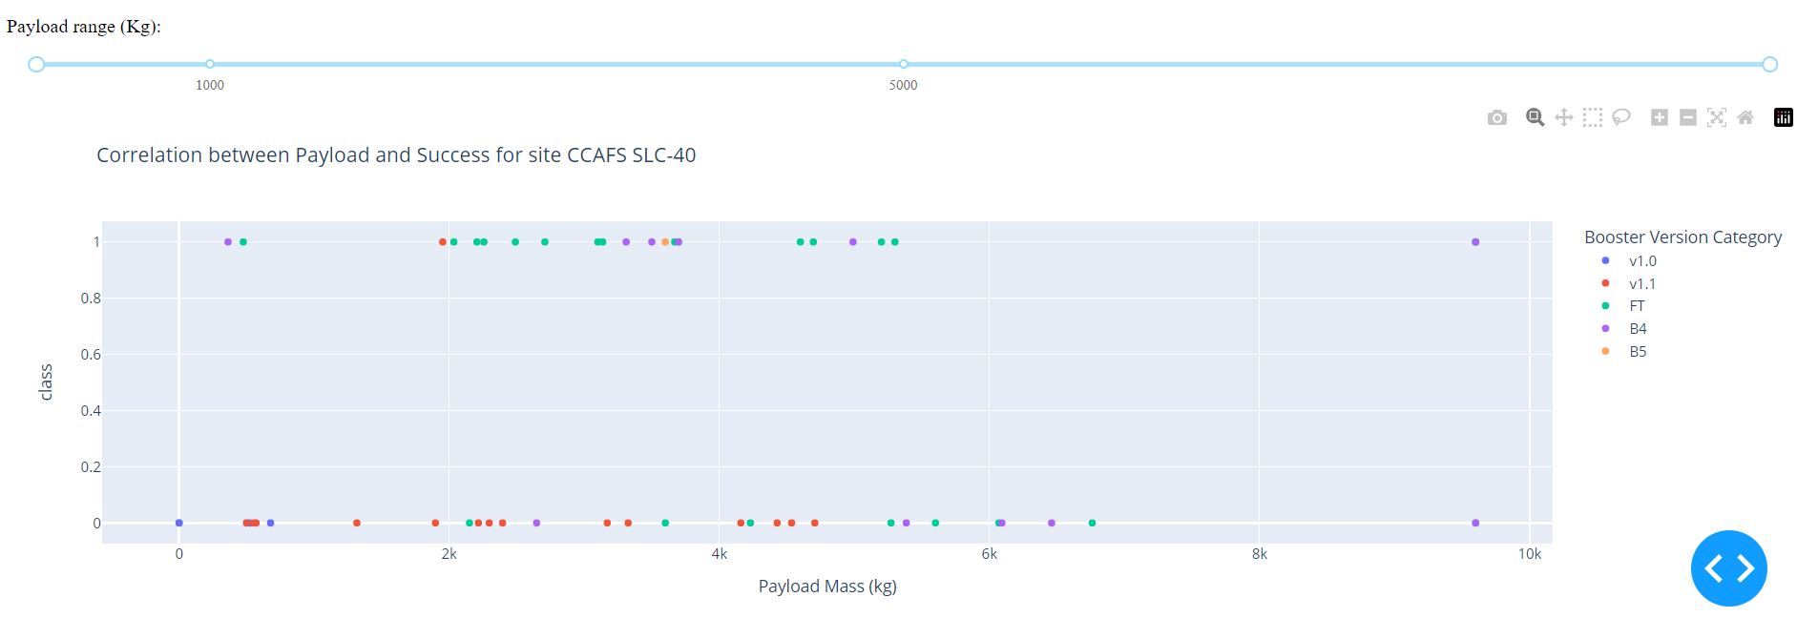
Payload vs. Launch Outcome scatter plot for all sites

Slide 44
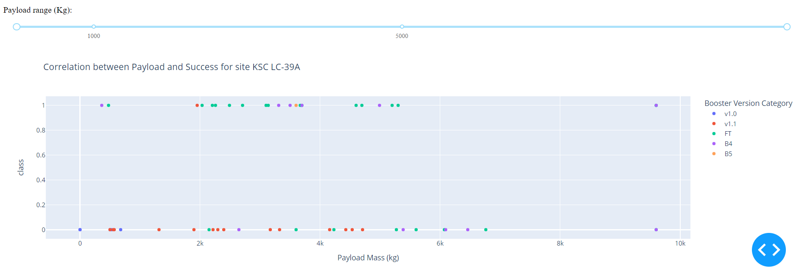
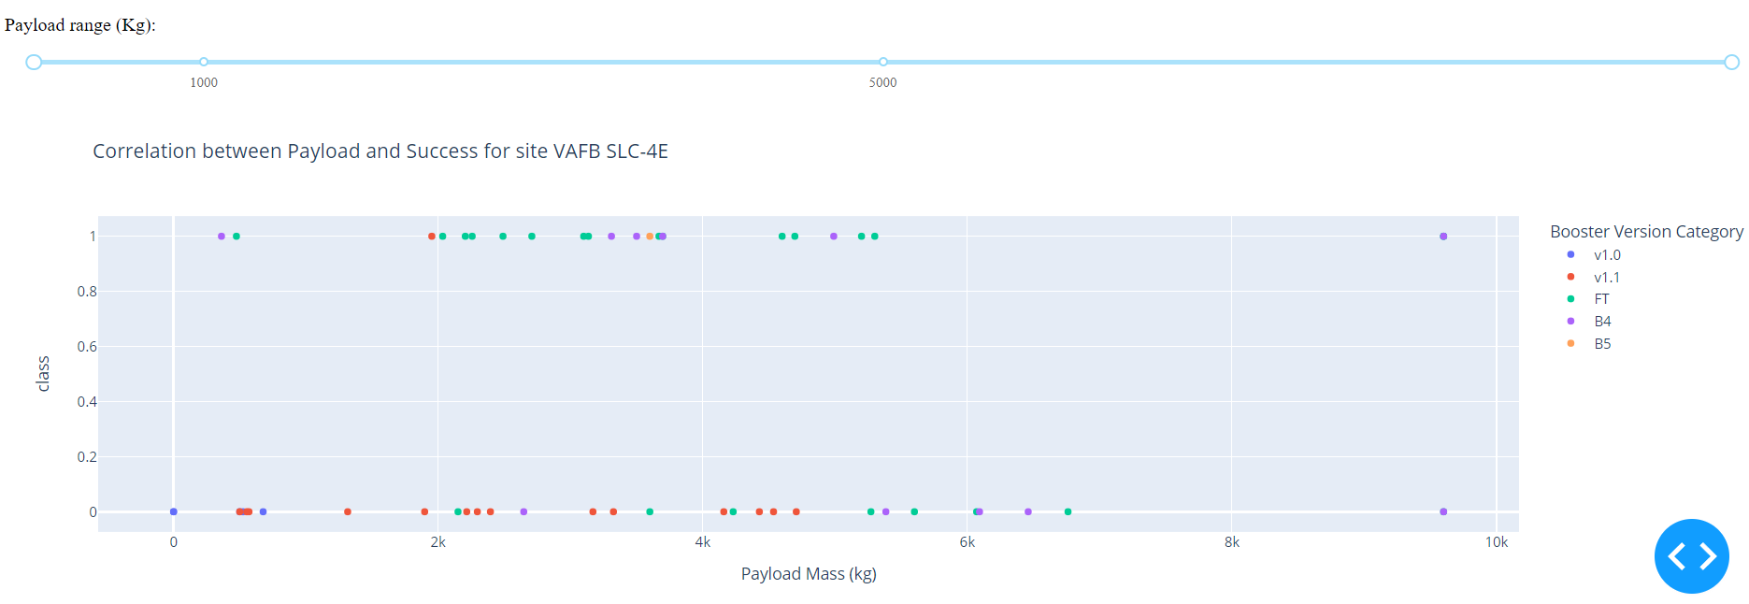
Cont.

Slide 45
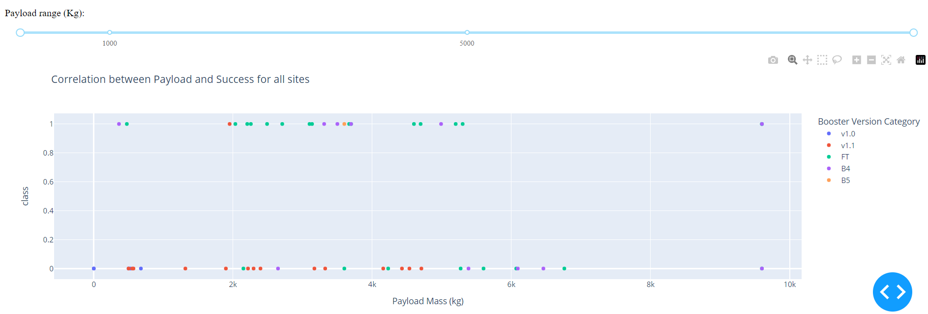
Cont.
For payload masses between 1000kg and 5000kg, the KSC LC-39A launch site has the highest success rate.
For payload masses less than 2000kg, almost all launch site has lowest launch success rate.
Booster version FT has the highest success rate of landing.

Slide 46

Section 5

Slide 47
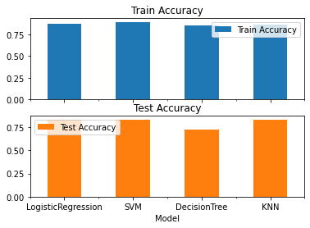
Classification Accuracy
LogisticRegression and SVM has similar and best train and test accuracy
Model | Train Accuracy | Test Accuracy
LogisticRegression | 87.50 | 83.33
SVM | 88.88 | 83.33

Slide 48
Confusion Matrix
The Confusion Matrix used to evaluate the performance of a each model, it will tell how many correct & wrong predictions are their.
Precision = TP/TP+FP = 12/(12+3) = 0.8
Recall = TP/TP+FN = 12/(12+0) = 1
F1 score = 2( P*R)/(P+R) = 2*(0.8*1)/(0.8+1) = 0.88
Accuracy = TP + TN / TP + TN + FP + FN. = (12+3) / (12+3+3+0) = 0.833

Slide 49
Conclusions
The fact that SpaceX can reuse the first-stage accounts for a large portion of its savings. The success rate of landing the first-stage has been rising Since 2013 until 2020.
Flight number, payload mass, launch site, Orbit are highly correlated with the success rate of the tests.
Launch sites are in close proximity to coastline, which minimizes danger to population dense areas.
KSC LC 39A launch site has the highest success rate about 77% of launch cases compared to all launch sites
By selecting the above parameters and using recent dataset SVM and Logistic Regression models can be used to predict the success of first-stage landing of new launches.

Slide 50
Appendix
All the project source codes are documented on GitHub with the following link
https://github.com/robeleq/IBM_Applied_Data_Science_Capstone_Project
External resources used are listed below
Falcon_9_first-stage_landing_tests
List_of_Falcon_9_and_Falcon_Heavy_launches
API SpaceX Data Launches

Slide 51


